Slide 1
Disclaimer
These slides are intended as presentation aids for the lecture. They contain information that would otherwise be to difficult or time-consuming to reproduce on the board. But they are incomplete, not self-explanatory, and are not always used in the order they appear in this presentation. As a result, these slides should not be used as a script for this course. I recommend you take notes during class, maybe on the slides themselves. It has been shown that taking notes improves learning success.

Slide 2
Reading for this set of slides
Craig – Intro to Robotics (3rd Edition)
1 Introduction
2 Spatial descriptions and transformations (2.1 – 2.9)
3 Manipulator kinematics (3.1 – 3.6)
7 Trajectory generation
Please note that this set of slides is intended as support for the lecture, not as a
stand-alone script. If you want to study for this course, please use these slides
in conjunction with the indicated chapters in the text books. The textbooks are
available online or in the TUB library (many copies that can be checked out for the entire semester. There are also some aspects of the lectures that will not be
covered in the text books but can still be part of the homework or exam. For those
It is important that you attend class or ask somebody about what was covered in class.

Slide 3
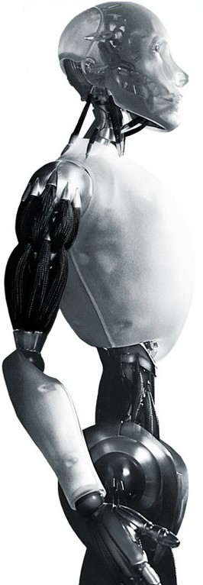
Robotics Controlling a Real Robot
TU Berlin
Oliver Brock
TexPoint fonts used in EMF.
Read the TexPoint manual before you delete this box.: AAAAAAAAAAAAA

Slide 4
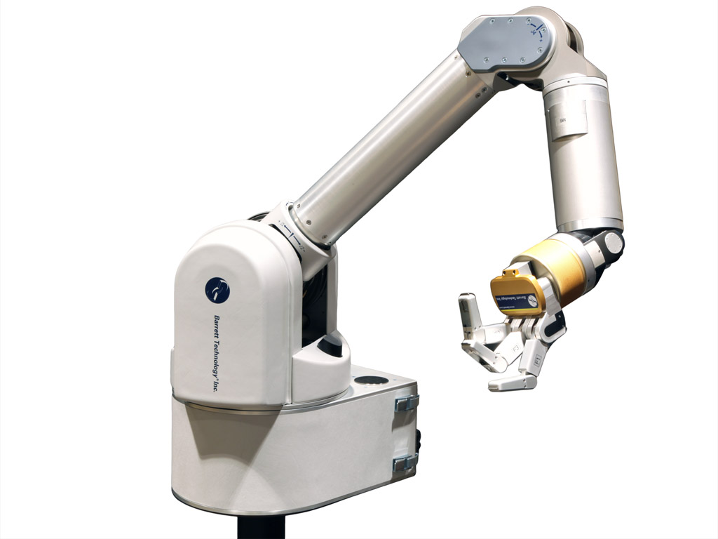
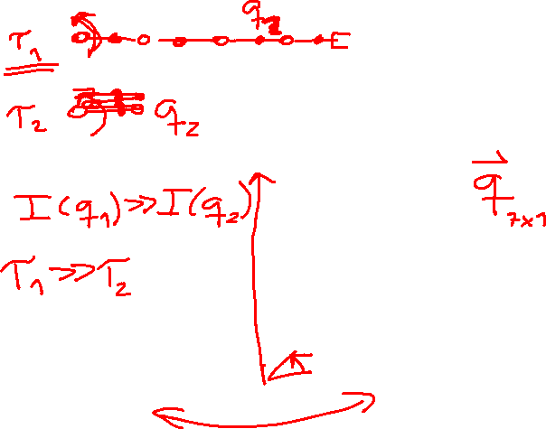

Slide 5
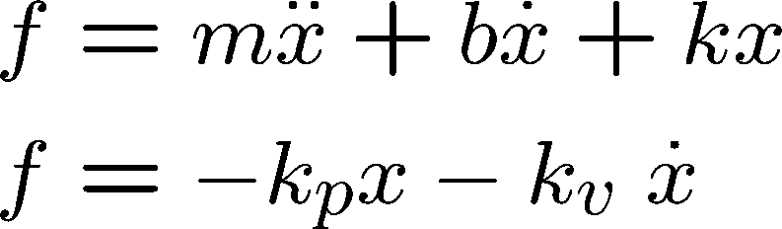
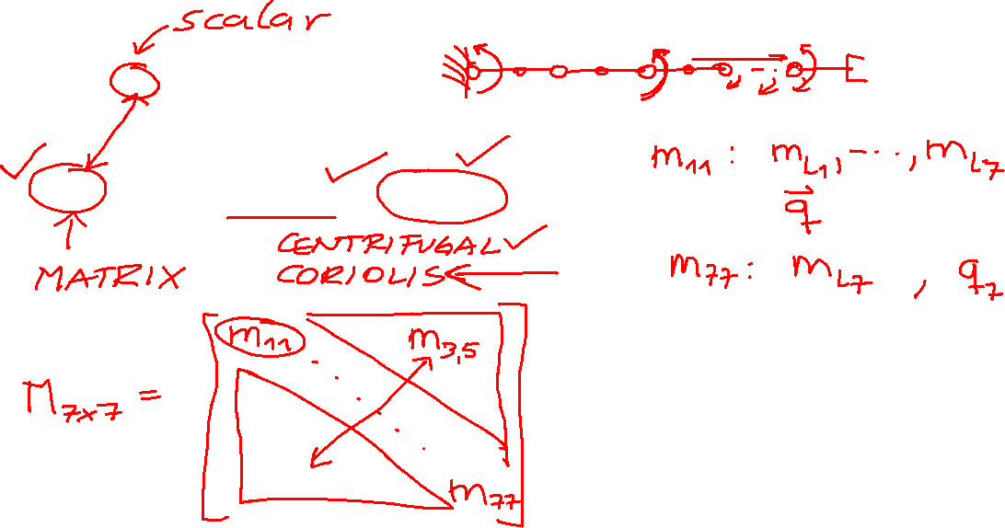
Equations of Motion

Slide 6

Our Planet – The Earth
Velocity at equator:
1673 km/h
464 m/s
Radius of earth at equator:
6,378.14 km
Angular velocity of earth:
|Ω| = |v| / |r| = 464 / 6,378,140 =
7.27 ¢ 10⁻⁵ rad/s =
0,00417 deg/s
Of course: 2π in 24 hours!

Slide 7

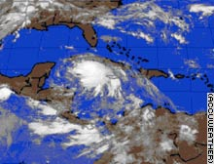

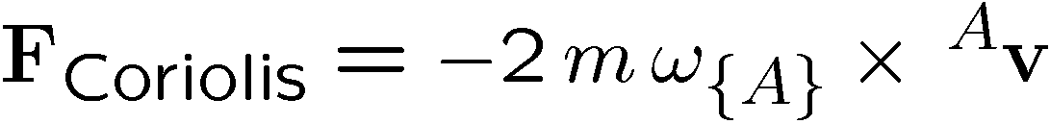
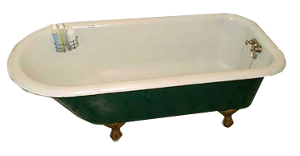
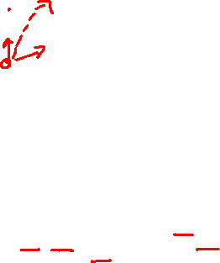
What are Coriolis Forces anyway?
☑
☑
☑
☒

Slide 8
Linearization
Control a nonlinear system
Use control law partitioning to extract nonlinear portion
Counteract or cancel nonlinear portion
Achieve overall linear behavior of system
Allows to treat the system as a unit mass

Slide 9
Linear versus Nonlinear Control
Linear control
systems described by linear differential eqns.
commonly used in industrial robots
dynamics are non-linear
often this approximation is useful
Nonlinear control
various forms of linearization
address nonlinearities

Slide 10
Control Law Partitioning
Idea: decomposition of control into model and servo portions
Extracts physical parameters from control problem ) unit mass system without friction etc.
Will be used to deal with nonlinear systems

Slide 11


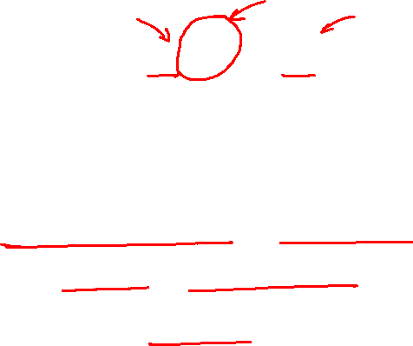
Control Law Partitioning
model portion
servo portion

Slide 12
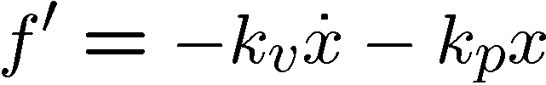

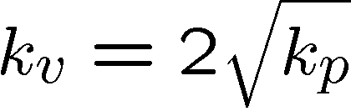
Unit Mass Controller
with
yields
for critical damping:
independent of physical system!

Slide 13

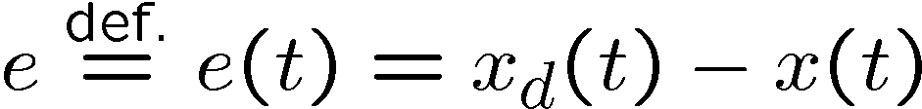
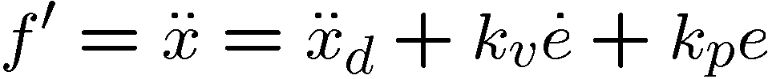

Trajectory or Motion Control
A trajectory specifies as a function of time:
Error is defined as

Slide 14
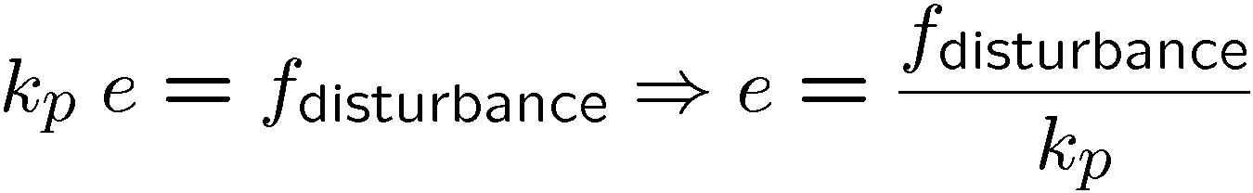
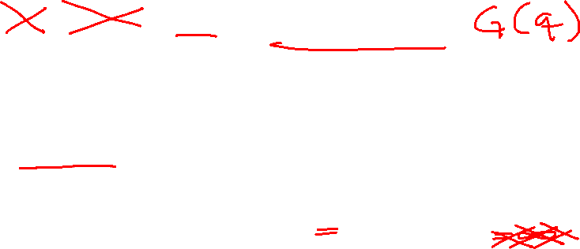
Disturbance Rejection
for bounded disturbances we can guarantee stability
Steady state error:
Error will never be zero in the presence of a
disturbance since k_{p} cannot be 1

Slide 15
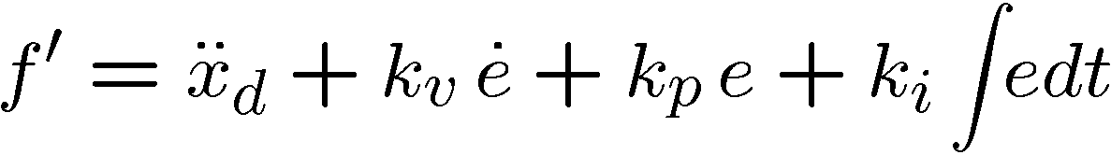
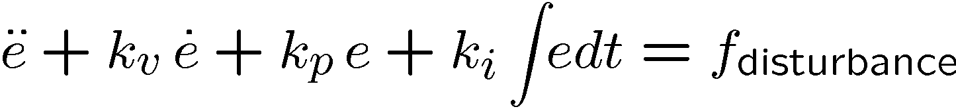
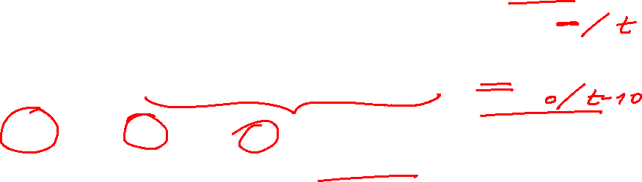
Integral Term gives PID Control
P = proportional
I = integral
D = derivative
control (feedback)
For simplicity, we will not consider the integral term.

Slide 16
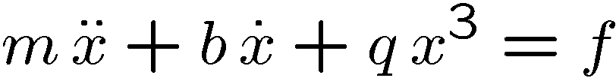


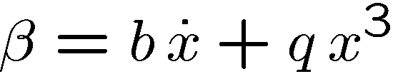

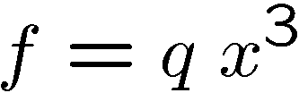
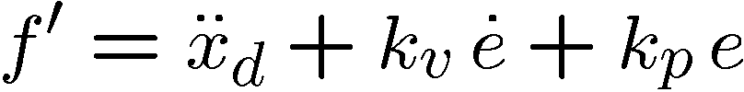
Linearization using Partitioning

Slide 17

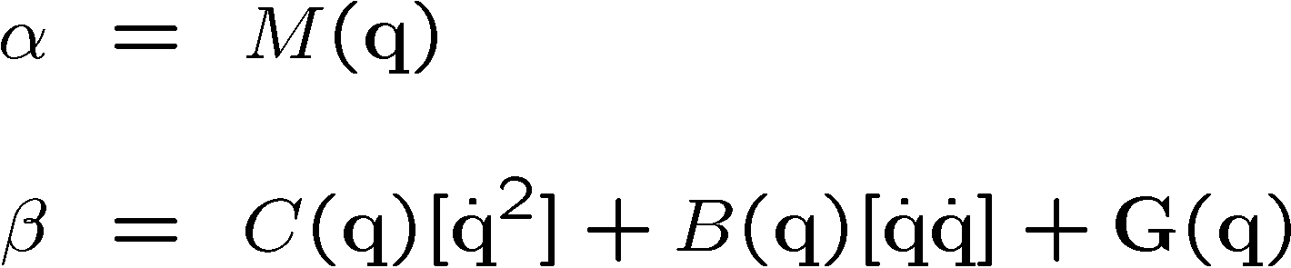
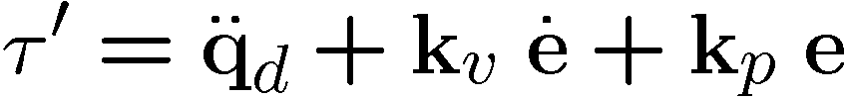
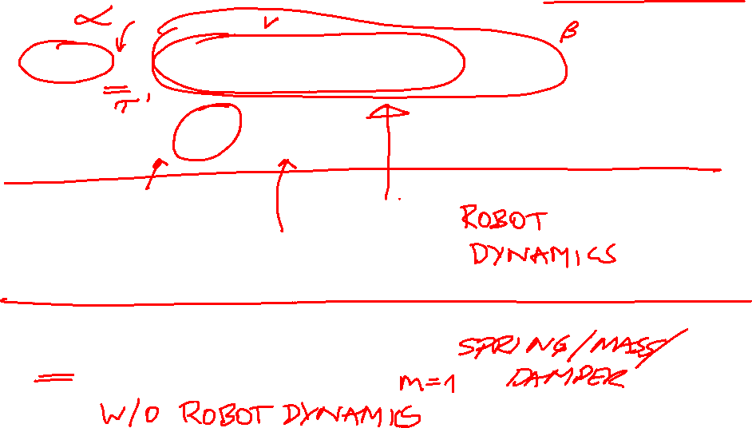
Linearization of Real Robot
Note that we have gone from a single mass to a system of masses!

Slide 18












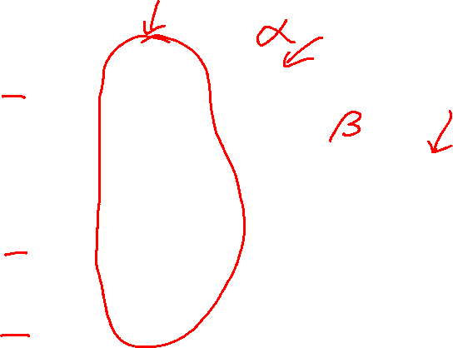
The Controller
+
Robot
+
+
+
+
+
-
+
-
feed-forward or model
feedback or servo

Slide 19
Recap
Single mass with spring (and damper)
Characteristics of motion
Design controller to achieve desired behavior for linear system
Partitioning for linearization of nonlinear system
“Vectorization” for unified approach to controlling a manipulator with many d.o.f.

Slide 20
Stability Analysis
In a linear system stability requires k_{v} > 0
Assuming bounded disturbance we can make certain guarantees
Analysis more complex in nonlinear systems
Linearization is not always possible
inaccurate models
unknown models

Slide 21


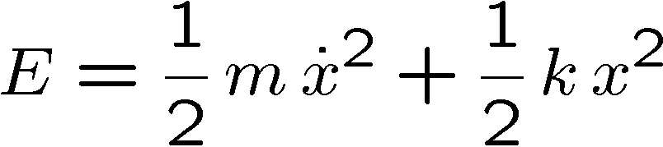
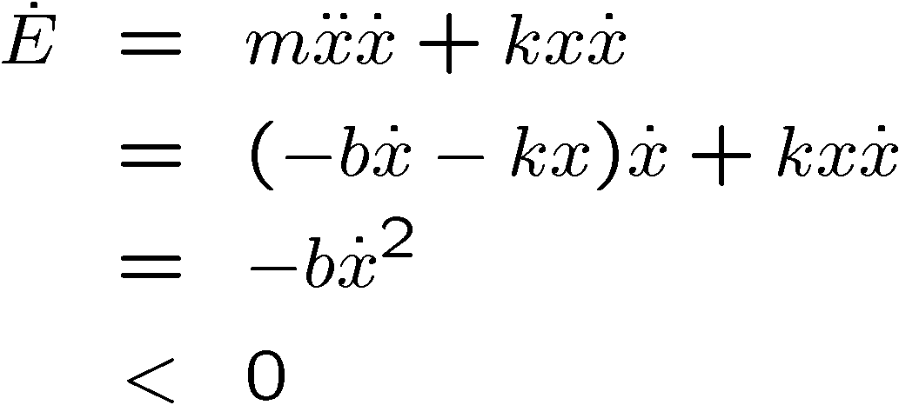
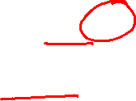
Energy-Based Stability Analysis
Energy of system is reduced until it comes to rest at x = 0

Slide 22
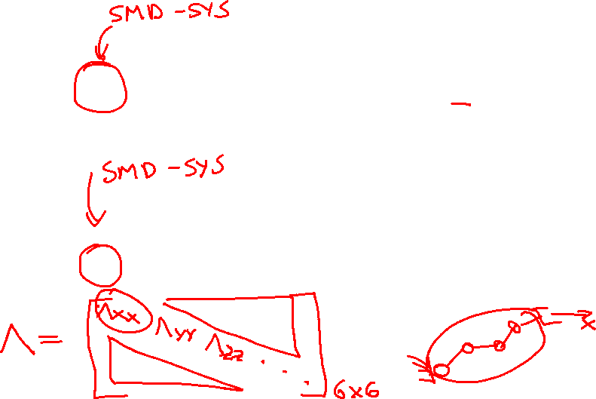
Equations of Motion
Joint Space
Operational Space

Slide 23



Effector Inertia Matrix Λ
Joint space:
Inertia perceived at the joints
Inertia perceived at effector?
Operational space inertia matrix

Slide 24

Notes:
Background image
https://www.pexels.com/photo/background-black-blackboard-board-159770/

